Slide 1

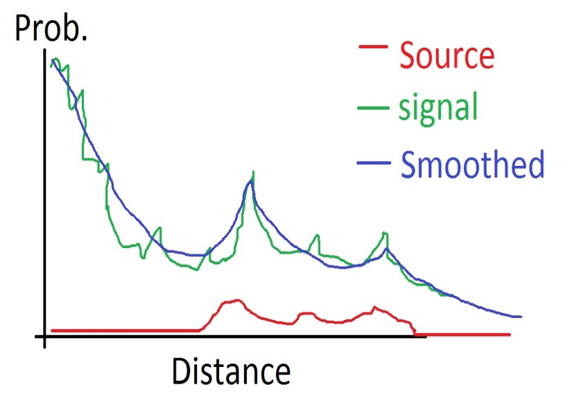
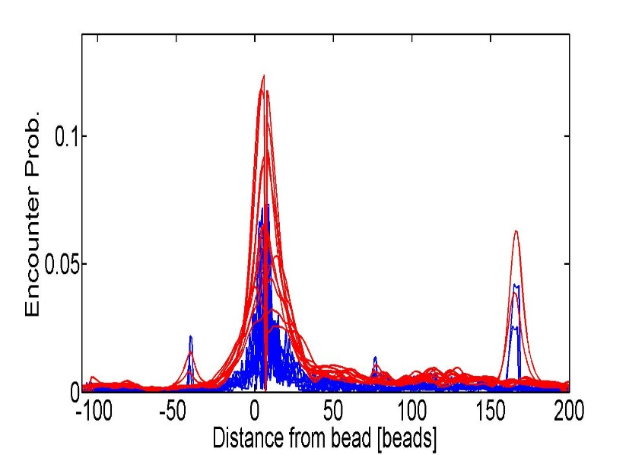
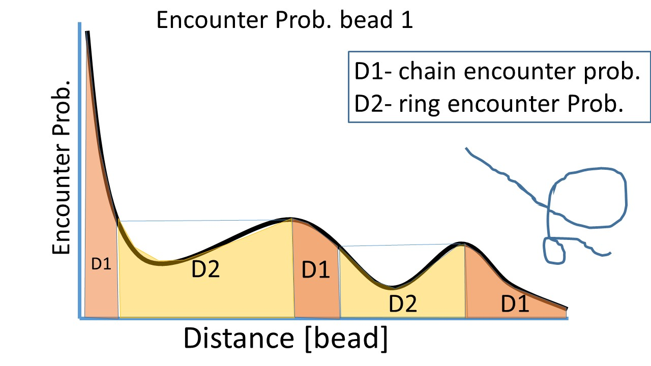
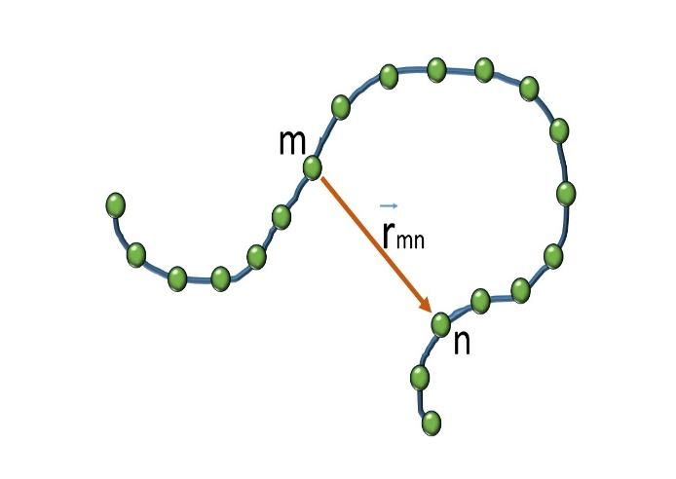
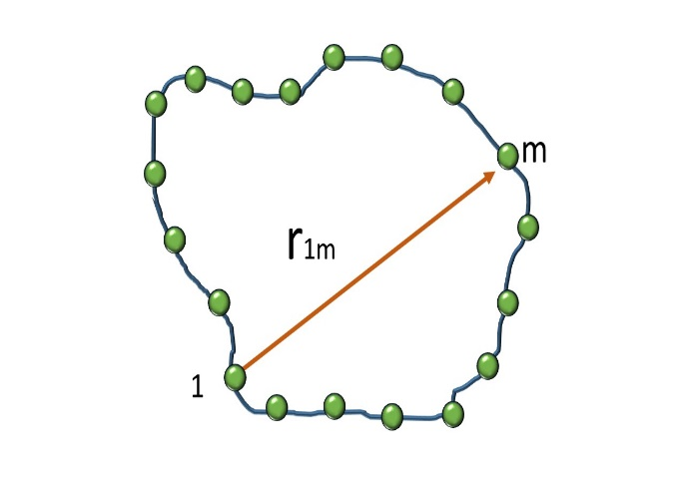
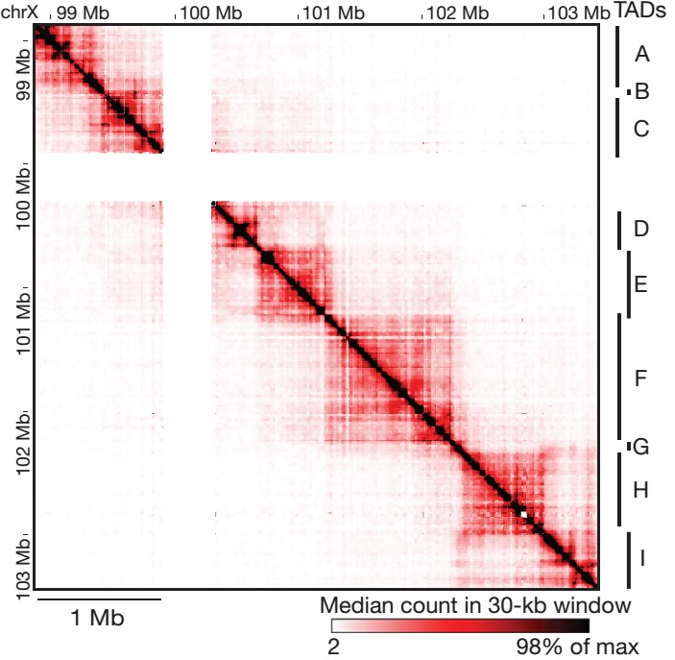
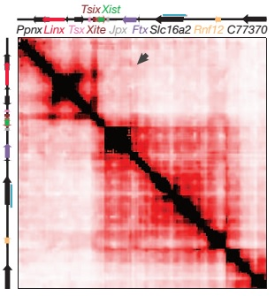
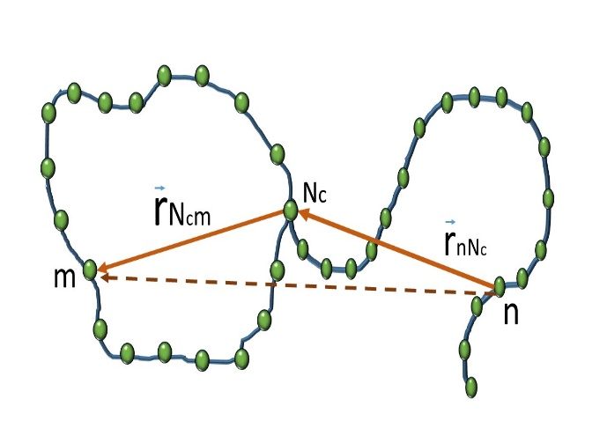
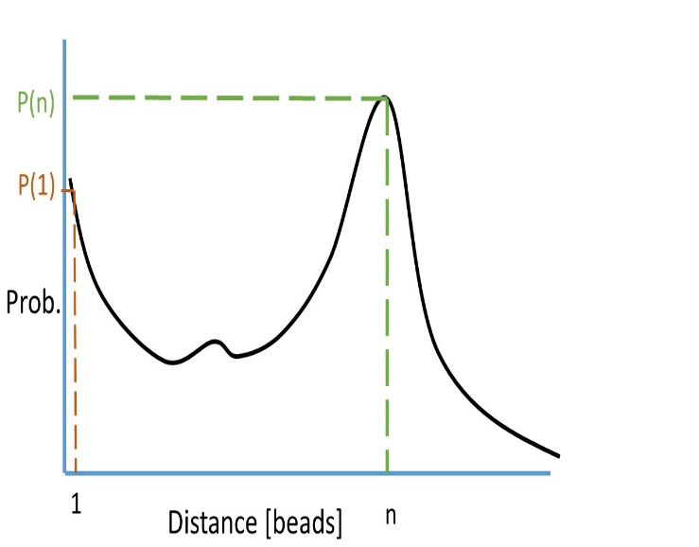
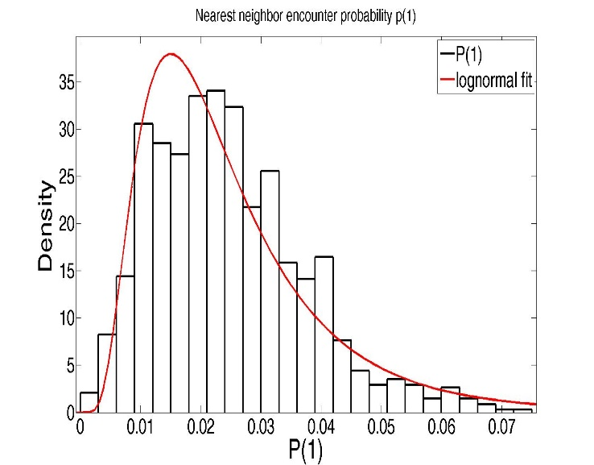
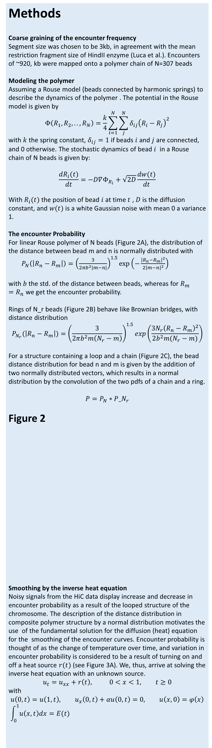
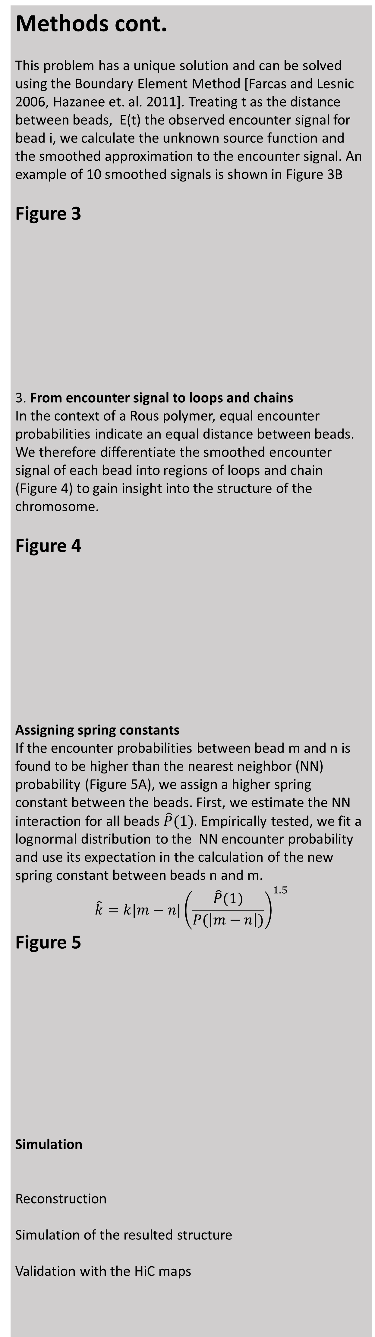
Reconstruction of the X-inactivation center structure using HiC encounter frequency maps
Ofir Shukron, David Holcman,
Departement de Biologie, Ecole Normale Superieure, 46 rue d’Ulm, 75005, Paris, France
Goal Reconstruct the local polymer architecture using HiC encounter frequency maps. Study the dynamic properties of the resulting structure, the encounter time distribution and Mean First encounter time (MFET) between different parts of a polymer.
Significance Providing a tool to transform static HiC encounter map to an average polymer structure, which captures salient features in the chromosome microstructure of the examined cells, allowing further mathematical analysis and simulation of the dynamics of a cross-linked polymer in various scenarios.
Background:
HiC experiment simultaneously captures millions of looping events of the chromosome. HiC steps are presented in Figure 1 A.
Analysis of the HiC encounter frequencies in mouse embryonic stem cells reveals the presence of stable Topologically Associating Domains (TAD) , in the 4.5Mb region of the X inactivation center figure 1B. However, the actual architecture in a specific stage of cell life is unknown
The data:
we use a subset of ~1Mb region of the X-chromosome around the X- inactivation center , provided by G.Luca et. Al.
Methods
Coarse graining of the encounter frequency Segment size was chosen to be 3kb, in agreement with the mean restriction fragment size of HindII enzyme (Luca et al.). Encounters of ~920, kb were mapped onto a polymer chain of N=307 beads
Modeling the polymer
Assuming a Rouse model (beads connected by harmonic springs) to describe the dynamics of the polymer . The potential in the Rouse model is given by $$Φ\left(R_{1},R_{2},..,R_{N}\right)=\frac{k}{4}\sum_{i=1}^{N}{\sum_{j}^{N}{{δ_{ij}\left(R_{i}−R_{j}\right)}^{2}}}$$ with $k$ the spring constant, $δ_{ij}=1$ if beads $i$ and $j$ are connected, and 0 otherwise. The stochastic dynamics of bead $i$ in a Rouse chain of N beads is given by:
$$\frac{dR_{i}(t)}{dt}=−D∇Φ_{R_{i}}+\sqrt{2D}\frac{dw(t)}{dt}$$
With $R_{i}(t)$ the position of bead $i$ at time $t$ , $D$ is the diffusion constant, and $w(t)$ is a white Gaussian noise with mean 0 a variance 1.
The encounter Probability
For linear Rouse polymer of N beads (Figure 2A), the distribution of the distance between bead m and n is normally distributed with $P_{N}\left(\left|R_{n}−R_{m}\right|\right)={\left(\frac{3}{2πb^{2}|m−n|}\right)}^{1.5}exp⁡\left(−\frac{{\left|R_{n}−R_{m}\right|}^{2}}{2{\left|m−n\right|}^{2}}\right)$ with $b$the std. of the distance between beads, whereas for $R_{m}=R_{n}$ we get the encounter probability.
Rings of N_r beads (Figure 2B) behave like Brownian bridges, with distance distribution
$$P_{N_{r}}(\left|R_{n}−R_{m}\right|)={\left(\frac{3}{2πb^{2}m\left(N_{r}−m\right)}\right)}^{1.5}exp\left(\frac{3N_{r}{\left(R_{n}−R_{m}\right)}^{2}}{2b^{2}m(N_{r}−m)}\right)$$
For a structure containing a loop and a chain (Figure 2C), the bead distance distribution for bead n and m is given by the addition of two normally distributed vectors, which results in a normal distribution by the convolution of the two pdfs of a chain and a ring.
$$P=P_{N}∗P_N_{r}$$
Figure 2
Smoothing by the inverse heat equation
Noisy signals from the HiC data display increase and decrease in encounter probability as a result of the looped structure of the chromosome. The description of the distance distribution in composite polymer structure by a normal distribution motivates the use of the fundamental solution for the diffusion (heat) equation for the smoothing of the encounter curves. Encounter probability is thought of as the change of temperature over time, and variation in encounter probability is considered to be a result of turning on and off a heat source $r(t)$ (see Figure 3A). We, thus, arrive at solving the inverse heat equation with an unknown source.
$$u_{t}=u_{xx}+r\left(t\right), 0<x<1, t≥0$$
with
$$u\left(0,t\right)=u\left(1,t\right), u_{x}\left(0,t\right)+αu\left(0,t\right)=0, u\left(x,0\right)=φ\left(x\right) \\ \int_{0}^{1}{u\left(x,t\right)dx=E(t)}$$
Methods cont.
This problem has a unique solution and can be solved using the Boundary Element Method [Farcas and Lesnic 2006, Hazanee et. al. 2011]. Treating t as the distance between beads, E(t) the observed encounter signal for bead i, we calculate the unknown source function and the smoothed approximation to the encounter signal. An example of 10 smoothed signals is shown in Figure 3B
Figure 3
3. From encounter signal to loops and chains
In the context of a Rous polymer, equal encounter probabilities indicate an equal distance between beads. We therefore differentiate the smoothed encounter signal of each bead into regions of loops and chain (Figure 4) to gain insight into the structure of the chromosome.
Figure 4
Assigning spring constants
If the encounter probabilities between bead m and n is found to be higher than the nearest neighbor (NN) probability (Figure 5A), we assign a higher spring constant between the beads. First, we estimate the NN interaction for all beads $\hat{P}(1)$. Empirically tested, we fit a lognormal distribution to the NN encounter probability and use its expectation in the calculation of the new spring constant between beads n and m. $$\hat{k}=k|m−n|{\left(\frac{\hat{P}(1)}{P(\left|m−n\right|)}\right)}^{1.5}$$
Figure 5
Simulation
Reconstruction
Simulation of the resulted structure
Validation with the HiC maps
Results:
In synthetic example, we see accurate reconstruction.
A
B
Figure 1
A
1. Cross-linking the polymer using formaldehyde
2. HindIII digestion
Polymer cross-links
3. Ligation
B
4. Reverse cross-linking, and PCR
A. Chain
B. Ring
C. Composite
A
B
Nora et. al 2012

